Slide 1
Chapter 7
Memory and I/O Decoding

Slide 2
Introduction
Previous chapter discussed about H/W structure of 8086 seen with few IC’s
Now focus is on the way Memory & I/O are connected to the processor
Every time we talk about memory, reading or writing from/to memory an address is referred
If it is a byte organized, then every location in memory that can store a byte of data has a unique address
Total space of 8086 is from 00000 to FFFFFH
Question is how each location gets unique address?
We also know that total address space of 1MB is not obtained by single chip of RAM
ROM is also a part of memory
Hence total no. of RAM & ROM chips together constitutes a total memory i,e the address space.

Slide 3
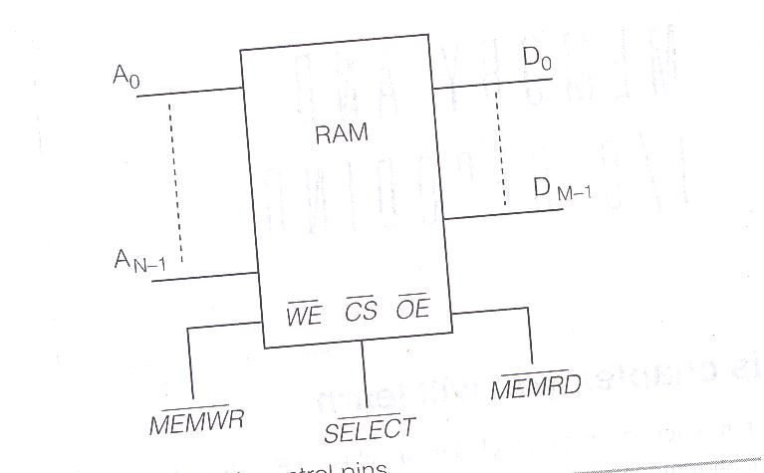
7.1 Memory Device Pins
Memory we talk about can be RAM or ROM
Difference is that ROM can only read from memory
so MEMWR signal from the processor does not have any relevance for ROM
Typical RAM with control pins are shown below

Slide 4
It has data lines D0 to DM-1
If it is a byte organized memory, the data lines are D0 to D7
Number of address lines (A0 to AN-1) depends on the number of locations it contains
Eg: if it is specified to be a 256 X 8 RAM, it means that it has 8 data lines and a storage capacity of 256 locations
thus it needs 8 address lines as 256 = 2⁸
thus in case of 1K X 8 RAM needs 10 address lines as 1K=1024=2¹⁰
Thus it is the capacity of the chip that decides the number of address lines.
coming to other pins of the chips, active low signal WE is to be connected to MEMWR signal from the processor side
Only if this pin is activated an the write operation be done in the addressed location
WE enables buffers of the data lines in the RAM

Slide 5
for reading the pin MEMRD is to be connected to the OE (output enable) pin of the memory chip for reading
when this pin is low, the output lines are activated, else they remain in tri-stated.
Some RAM devices have only a single pin for reading or writing, which is R/W
It is obvious that only one of the activities (read or write) can occur at a time
The pin CS (Chip enable or select) is the pin which enables the memory chip.
As no activity is possible if the pin is inactivated
Pin gets activated only if the address placed on the address bus of the processor is one of the address in the address range of chip.
As this condition satisfied, a select pulse from address decoder output & memory chip turn ON
ROM chip is similar except it does not have a WE pin

Slide 6
Why Active Low Control Signals?
Most of the signals discussed are active low.
This is a TTL (Transistor- Transistor Logic) concept.
Stray capacitances of the control pins can get charged from noise voltages, as this may cause the signals to cross the threshold ‘high’ level as defined for TTL
if the control signals are active high, it may cause wrong triggering
Problems

Slide 7
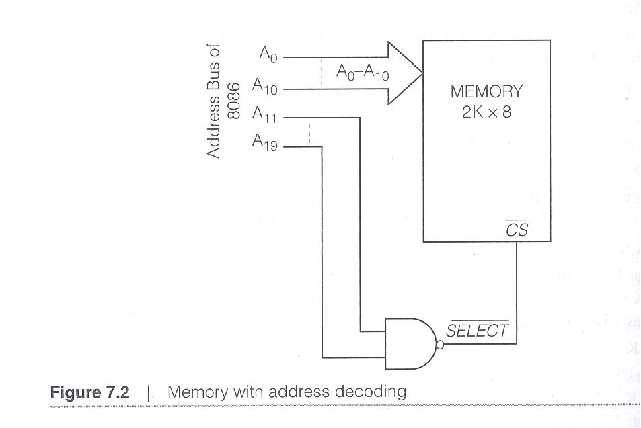
7.2 Memory Address Decoding
Fig shown with 2K X 8 memory chips
The memory chip has 11 address lines, that are directly connected to the 11 lower lines of the address bus of the processor
remaining 9 lines of the address bus of the processor are connected to the inputs of a NAND gate whose output pin feeds the CS pin of the memory chip.

Slide 8
It is obvious that the chip is selected (enabled) only if all the input lines of the NAND gate are high
Means A₁₁ – A₁₉ of the address has to be high for the memory chip to be selected and made active.
NAND gate thus functions as the address decoder for the memory
It fixes up the address range of the chip
PROBLEMS

Slide 9
7.2.1 Address Decoding Concept
Basic idea of address decoding is to decode the extra unused address lines of the processor to specify the address range
When more chips are to be interfaced, decode the extra address lines to a different range for each group
Any logic/logic gate can be used to perform address decoding
In general, address decoding can be built using:
- Random logic (Simple Gates)
- Block decoders ( e.g. 2x4, 3x8, ...)
- Programmable Logic (PLAs, CPLDs, FPGAs,....)
Problems

Slide 10
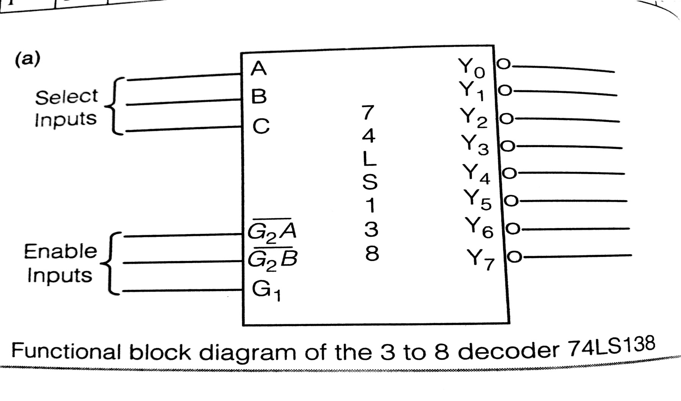
7.2.2 Address Decoding Using Block Decoders
Popular decoder is the 3 to 8 decoder (74LS138)
Here output lines are active low
To enable the decoder chip, it must be ensured that G2A and G2B are at logic level 0 & G1 is at logic 1.

Slide 11
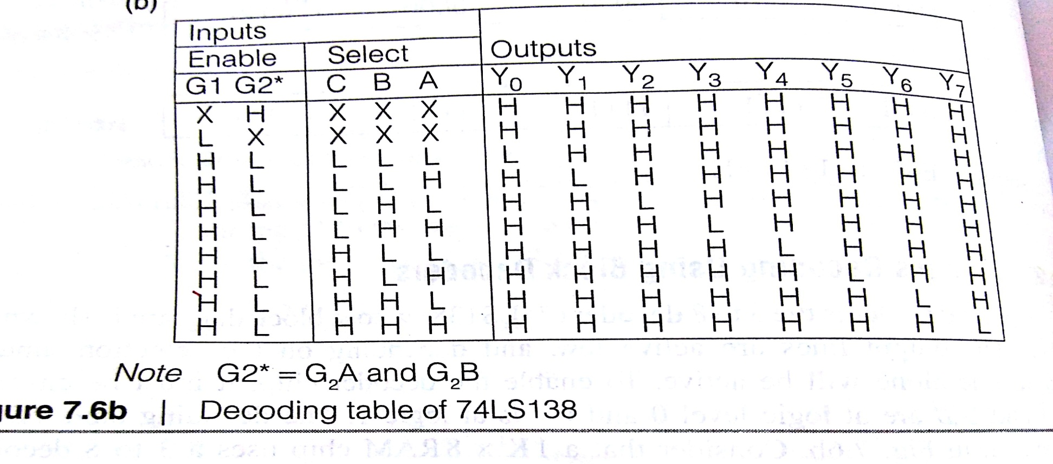
Decoding of the chip is shown below
Lets take a 1K X 8 RAM chip that uses a 3 to 8 decoder for memory decoding
Here RAM has 10 address lines
So remaining 10 lines of the processor can be used for decoding
Need o calculate the address space

Slide 12
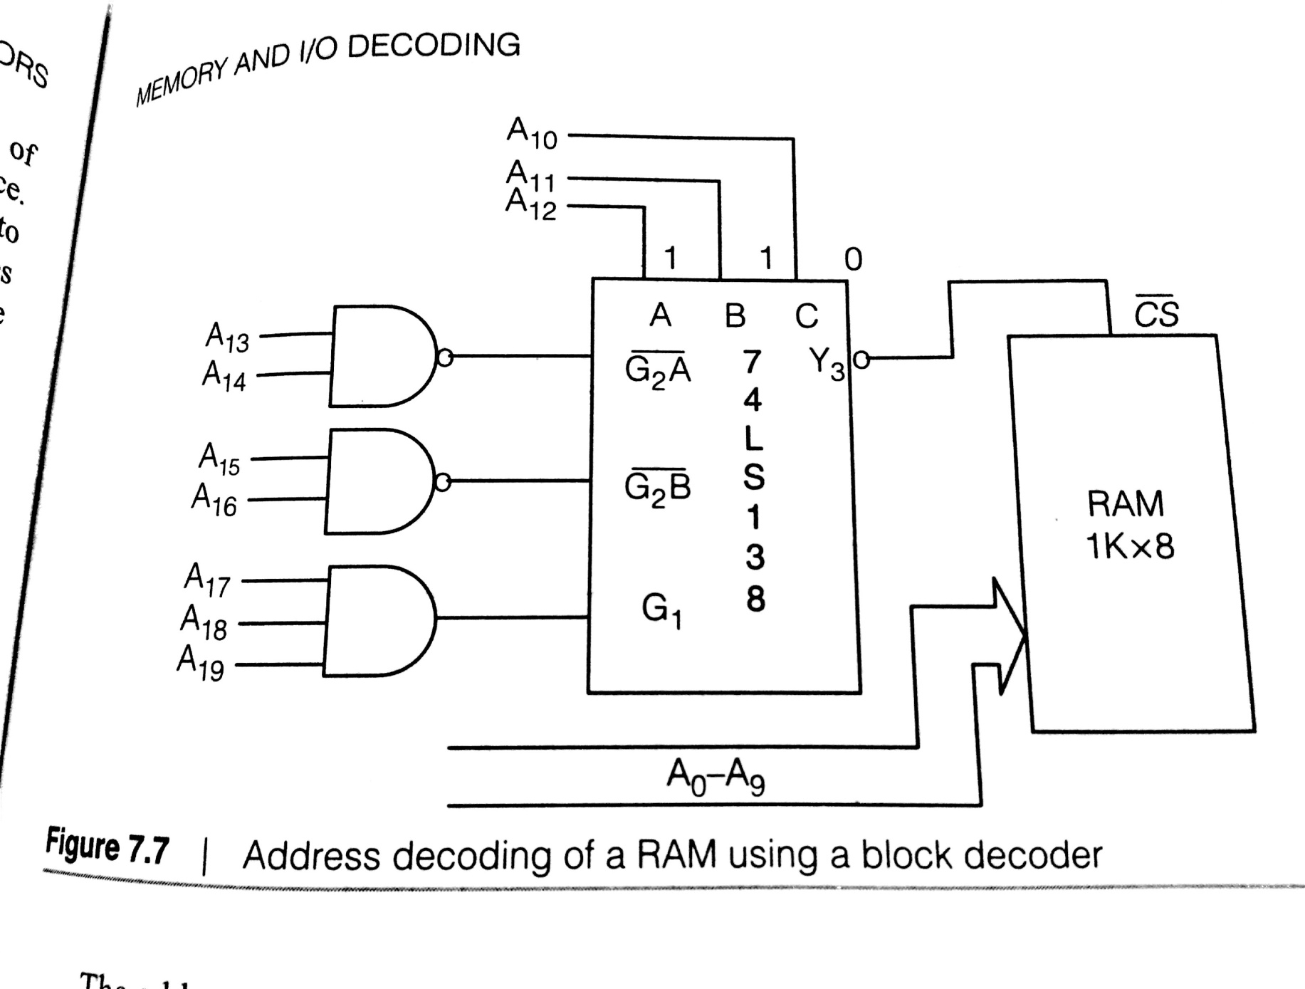
Consider the hardware connection

Slide 13
The address lines A0 to A9 from the address bus of the processor are directly connected to the address lines of RAM
Logic on these lines can vary from 00 0000 0000 to 11 1111 1111
Remaining 10 address lines of the processor are used for address decoding
Thus we see them connected to the pins of the decoder
To enable the decoder G2A and G2B must be 0 & G1 must be 1.

Slide 14
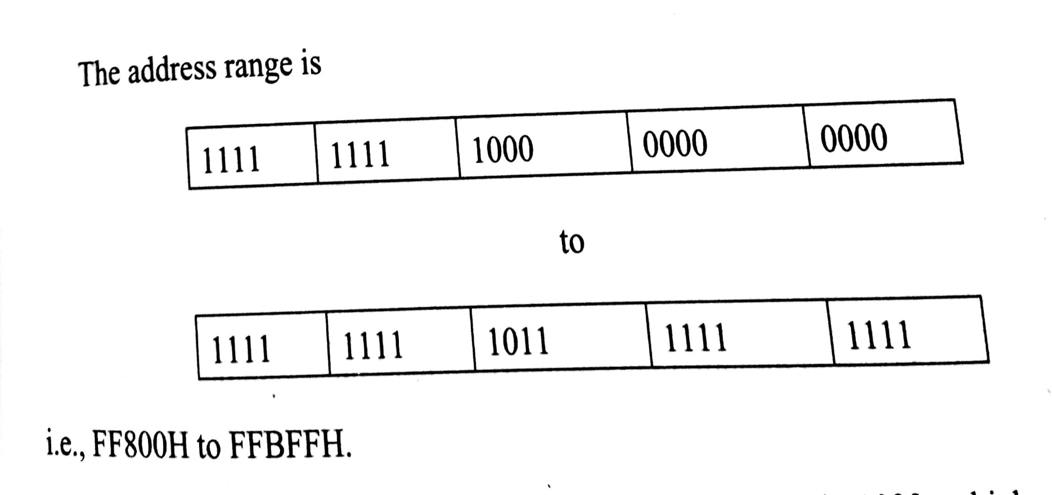
Also to enable Y3, CBA must be 011
Thus the logic on the lines from A19 to A10 should be 1111 1111 10
Thus the upper & lower range of the address is as shown below.

Slide 15
7.2.3 Partial Address Decoding
In hardware connection between a memory & a processor

